Slide 1
Automatic Digital Signature
PHIS Exports Module
Notes:
The following slideshow demonstrates how the automatic digital signature is applied to the export certificate package. Please note that personally identifiable information and establishment information has been redacted.

Slide 2
Consumer Safety InspectorInspector
Notes:
Start from the PHIS homepage, in this case logged in as a Consumer Safety Inspector. Select the “Export” option from the left navigation menu.

Slide 3
Consumer Safety Inspector
Consumer Safety Inspector
Notes:
The export menu will expand…

Slide 4
Consumer Safety Inspector
Notes:
Select “9060”…

Slide 5
Consumer Safety Inspector
Consumer Safety Inspector
SMITH
SMITH
SMITH
SMITH
SMITH
SMITH
Notes:
This will open the View Export Records grid. Here we’re just demonstrating that you can expand the date range if needed (though in this case we’re going to look at a recently submitted application package).

Slide 6
Consumer Safety Inspector
Consumer Safety Inspector
SMITH
SMITH
SMITH
Notes:
We’re going to select this second item, with the unchecked calendar icon. Notice that the export is to Bermuda, which is one of the Phase 4 countries in the PHIS export module.

Slide 7
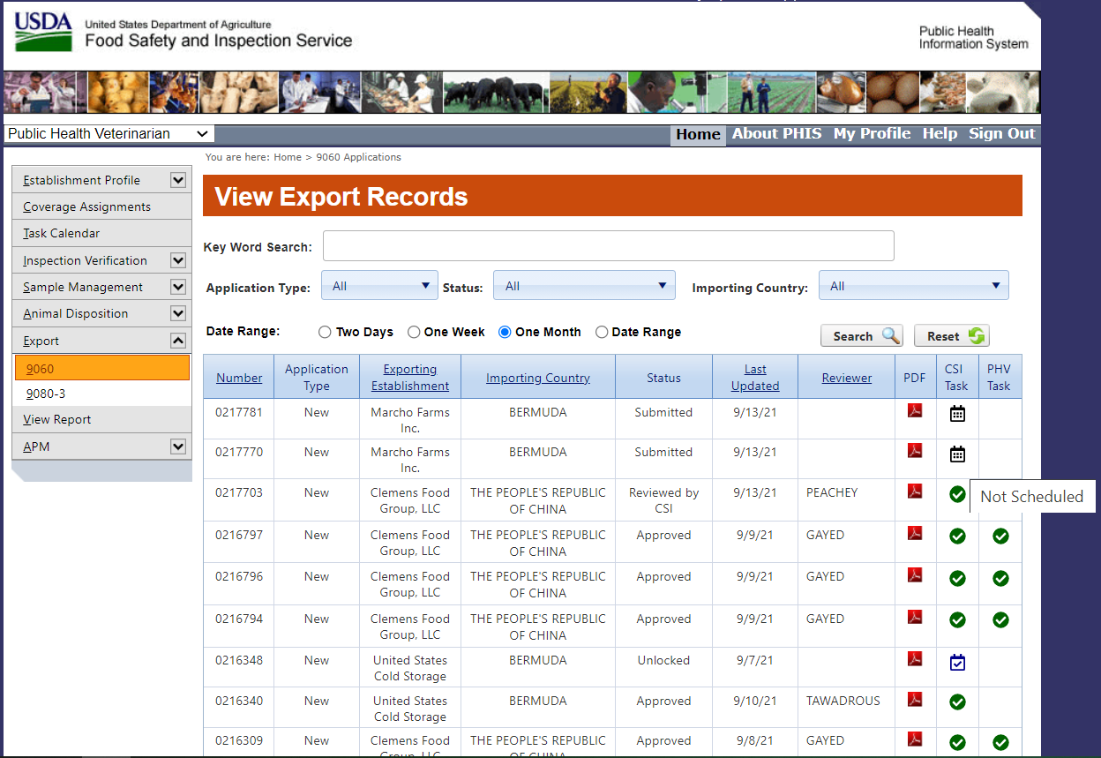
Consumer Safety Inspector
Consumer Safety Inspector
SMITH
SMITH
SMITH
SMITH
SMITH
SMITH
Notes:
Click on the calendar icon to schedule the export task.

Slide 8
Notes:
This will bring up the task assignment calendar…

Slide 9
Notes:
We’ll add one task to the box for today…

Slide 10
Notes:
Then we’ll need to go to the “Reason” dropdown menu….

Slide 11
Notes:
Here you can see the menu expanded.

Slide 12
Notes:
As with most export tasks, we’re going to select “unplanned routine task.”

Slide 13
Notes:
Here we confirm our selection. Then we click save.

Slide 14
Consumer Safety Inspector
Consumer Safety Inspector
SMITH
SMITH
SMITH
SMITH
SMITH
SMITH
Notes:
Now you can see the calendar icon has a checkmark in it, meaning it’s been scheduled. Click on the calendar icon to enter the task.

Slide 15
Joe Smith
Notes:
Go through all the tabs, starting with the Activity tab.

Slide 16
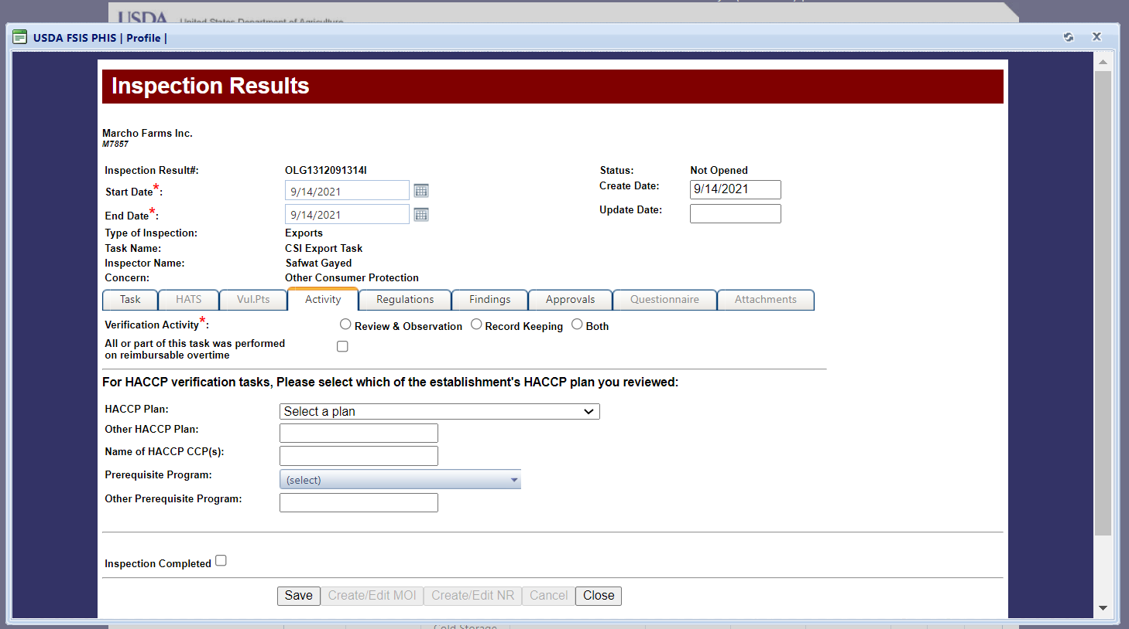
Joe Smith
Notes:
In this case, we’re going to select both, because we’re both reviewing the paperwork and visually inspecting the product to be exported.

Slide 17
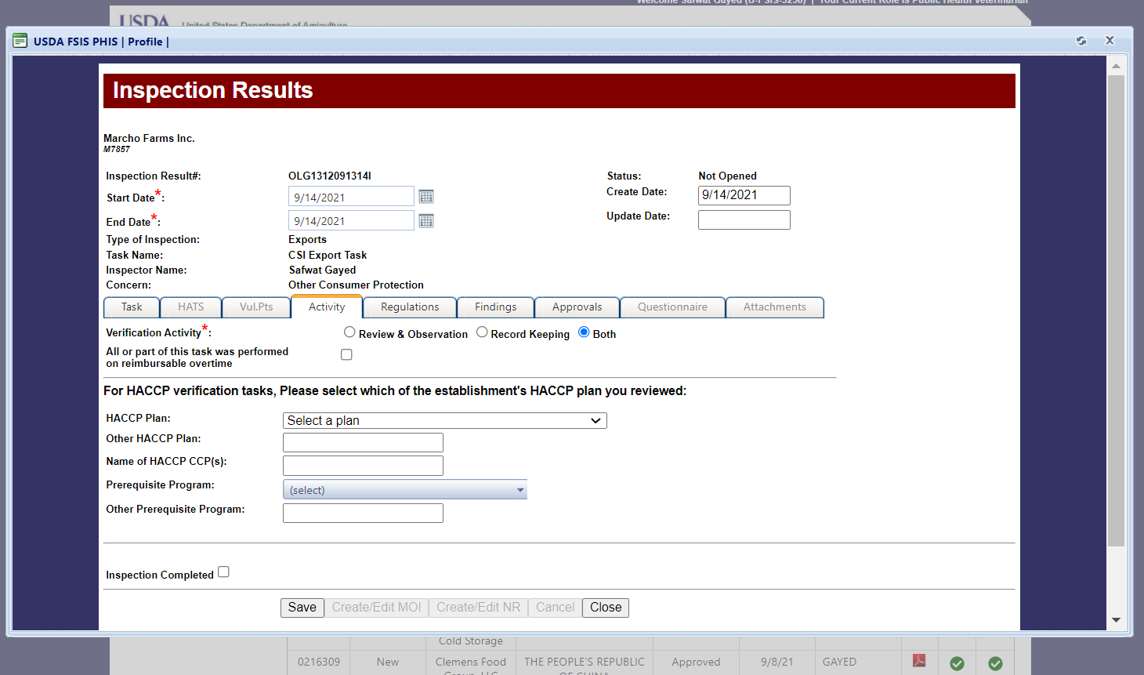
Joe Smith
Notes:
It’s always a good idea to save your data after each tab.

Slide 18
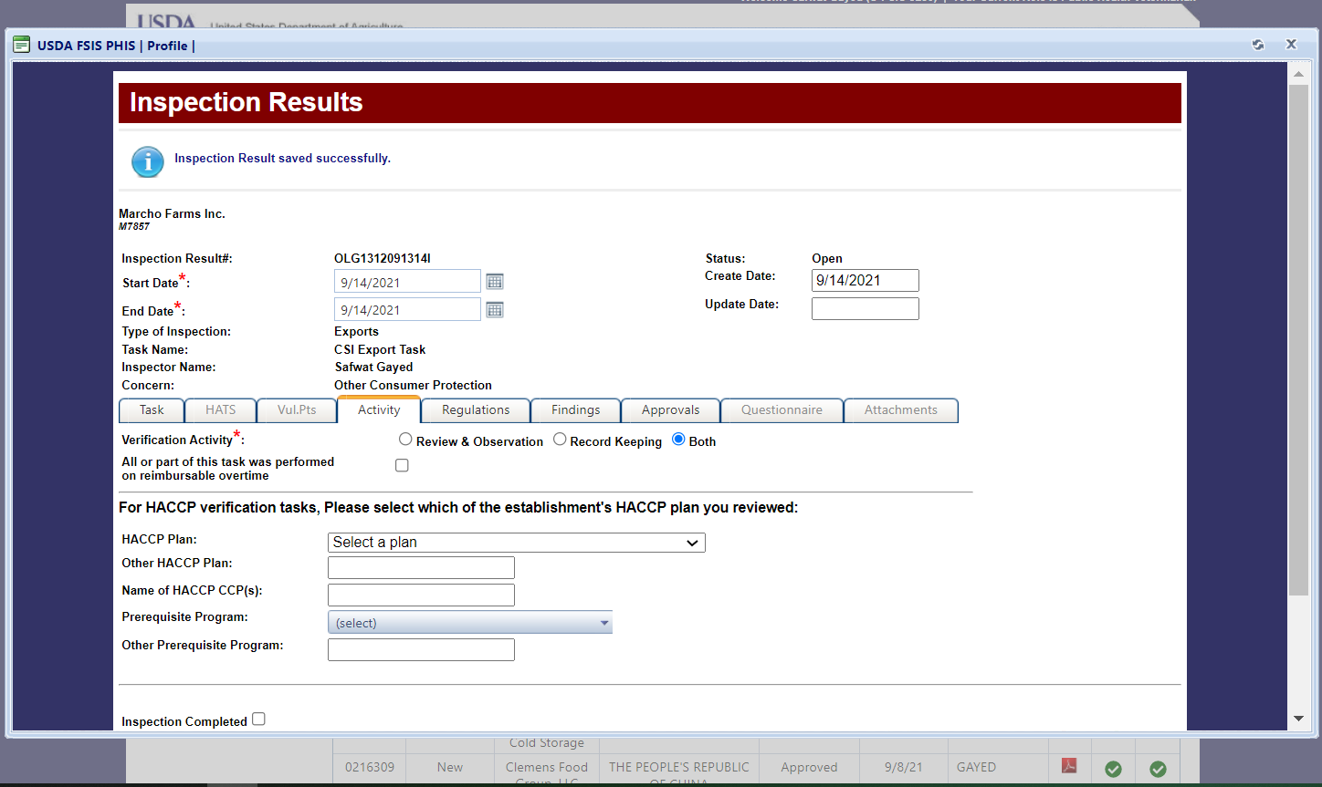
Joe Smith
Notes:
You have a confirmation message at the top of the screen that your data has been saved. Next, go to the Regulations tab.

Slide 19
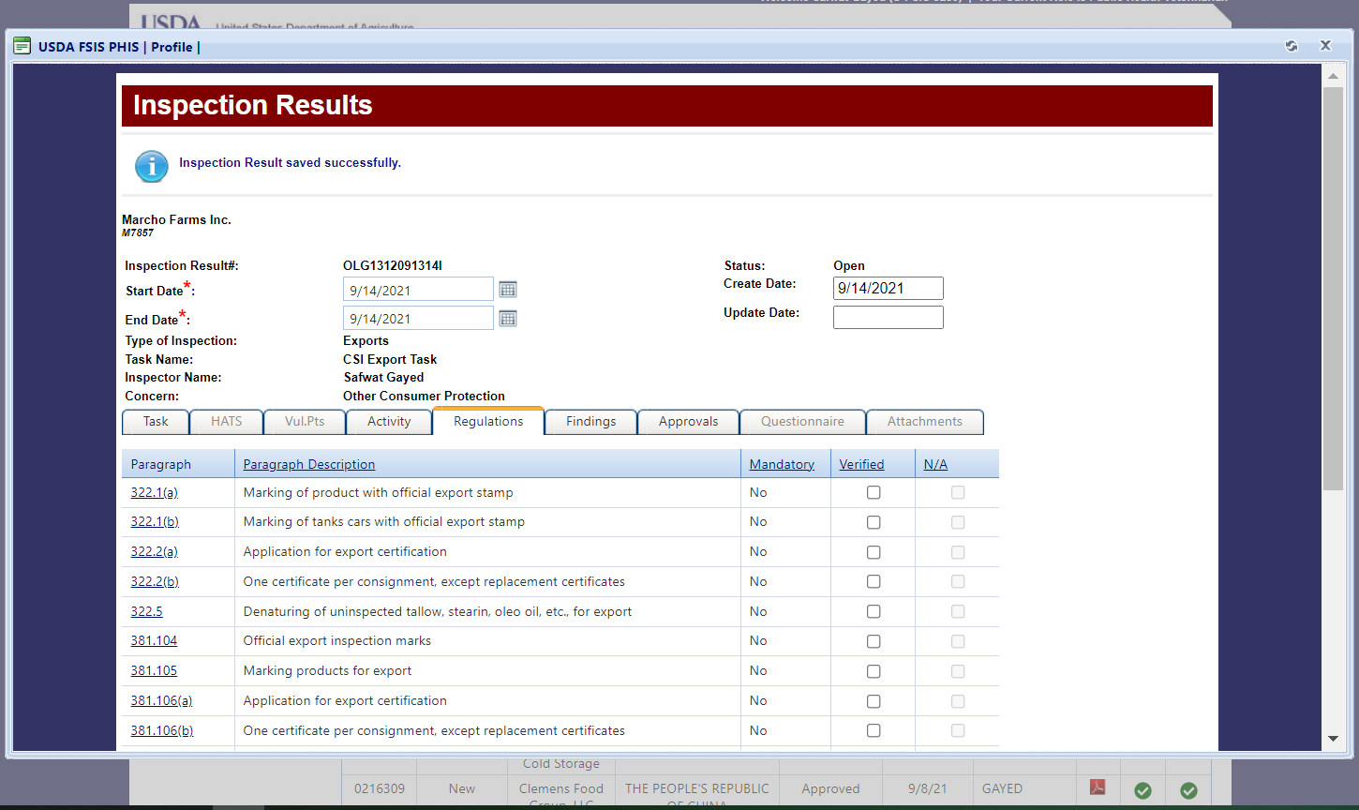
Joe Smith
Notes:
This will open your list of applicable regulations.

Slide 20
Joe Smith
Notes:
In this case, we’ll select these three.

Slide 21
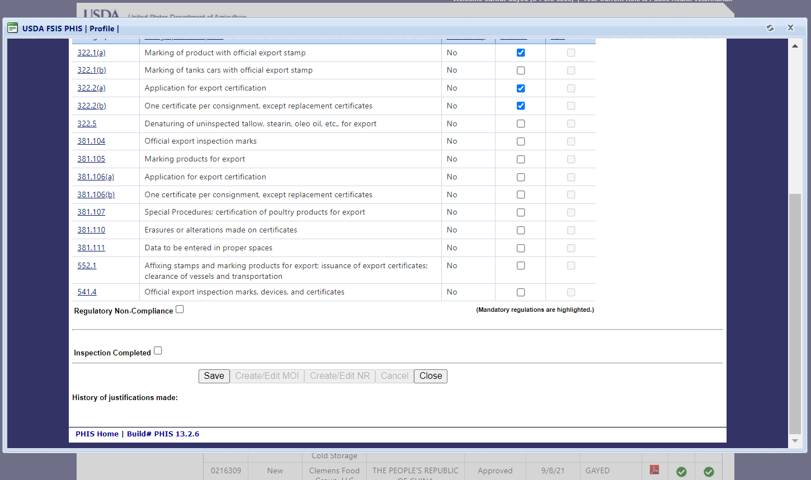
Notes:
Then we’ll scroll down and save again.

Slide 22
Joe Smith
Notes:
Again, we have confirmation that the data is saved. Now go to the findings tab.

Slide 23
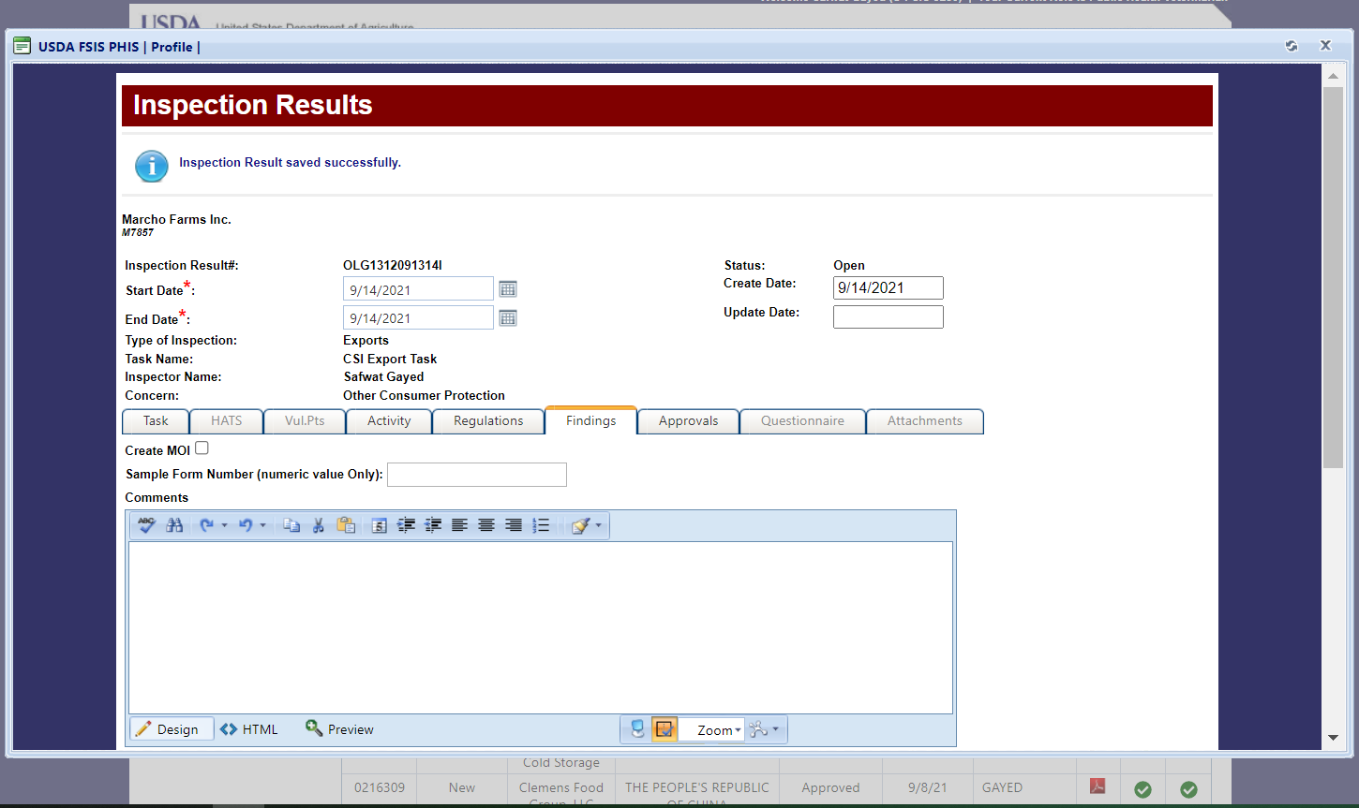
Joe Smith
Notes:
People may sometimes tend to skip over the Findings tab, but you may wish to enter some basic comments even if there is nothing wrong with your inspection.

Slide 24
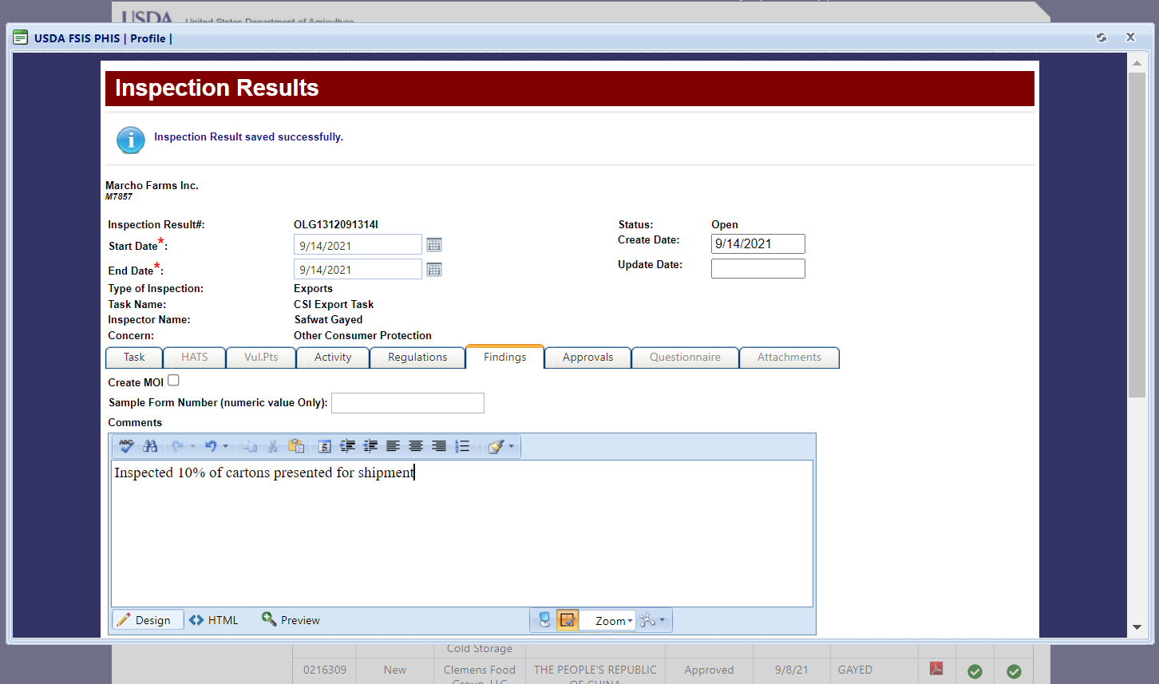
Joe Smith
Notes:
In this case, we’ll just write in that we visually inspected about 10% of the presented product.

Slide 25
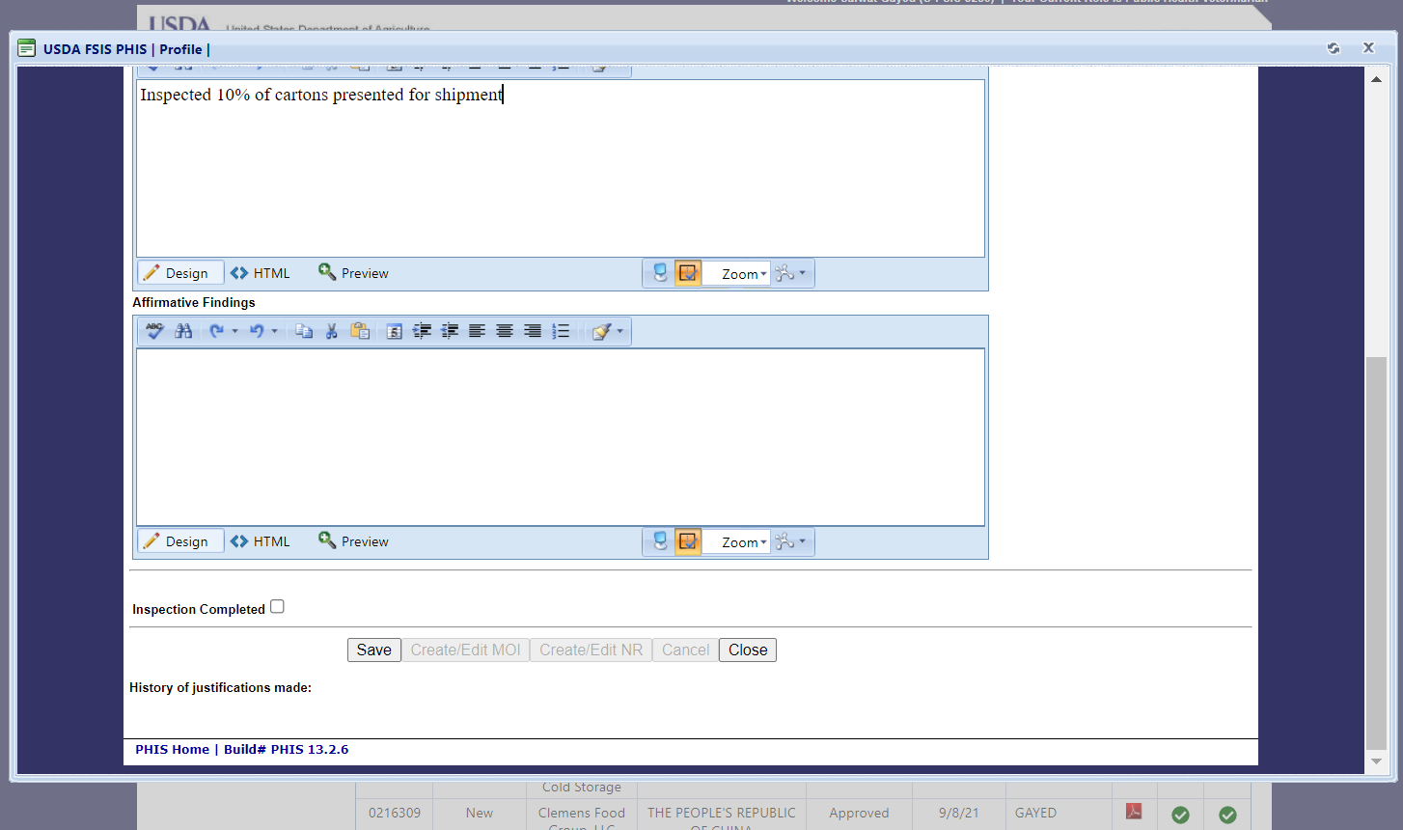
Notes:
The we’ll save again…

Slide 26
Joe Smith
Notes:
Our data saving is confirmed. Finally, let’s go to the Approvals tab.

Slide 27
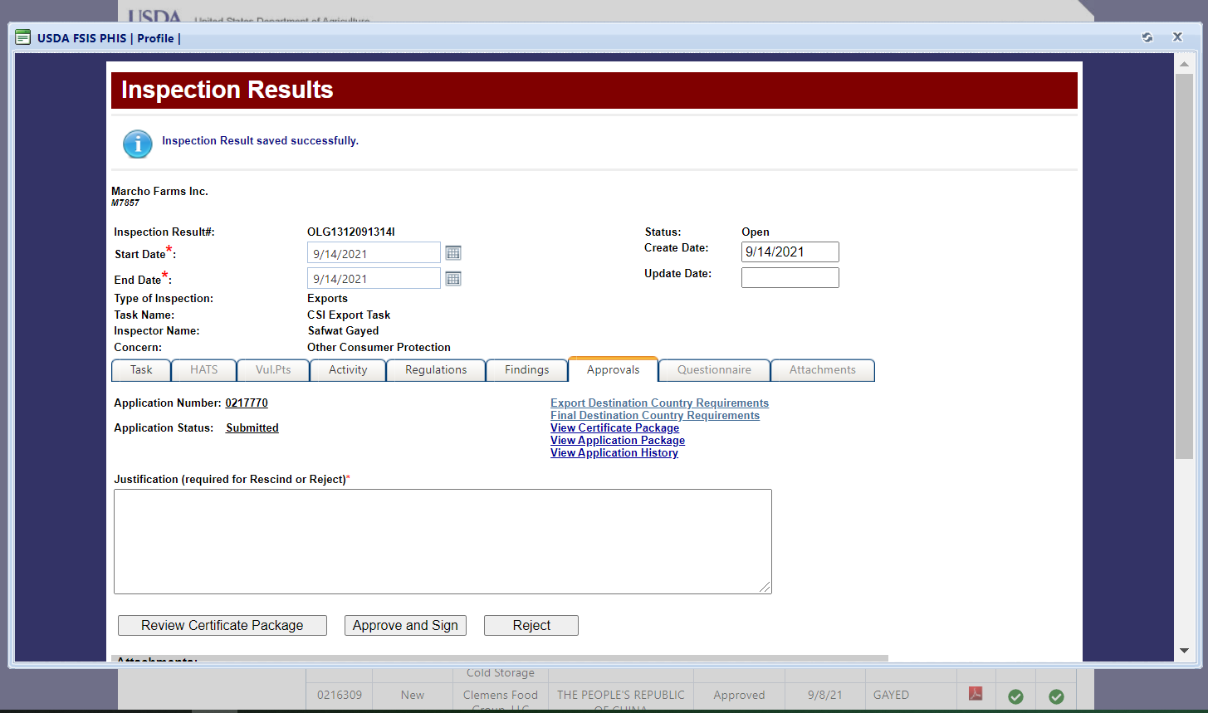
Joe Smith
Approve and Sign
Notes:
You will need to go through each of the hyperlinks before completing the export certification. We’ll start with looking at the Export Destination Country Requirements.

Slide 28
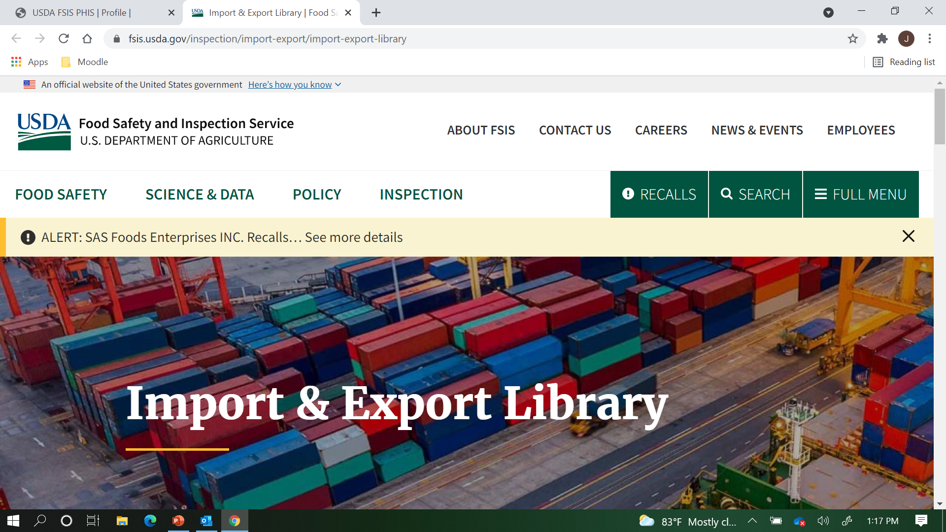
Notes:
This will take you to the FSIS Export Library. You would need to find the destination country and select Export to see the requirements, but we will skip those steps for the purpose of this demonstration. Just keep in mind you should be checking the requirements frequently, as they can change suddenly.
We’ll close this tab and go back to PHIS…

Slide 29
Joe Smith
Approve and Sign
Notes:
I like to look at the Application Package first, but you can go through them in any order.

Slide 30
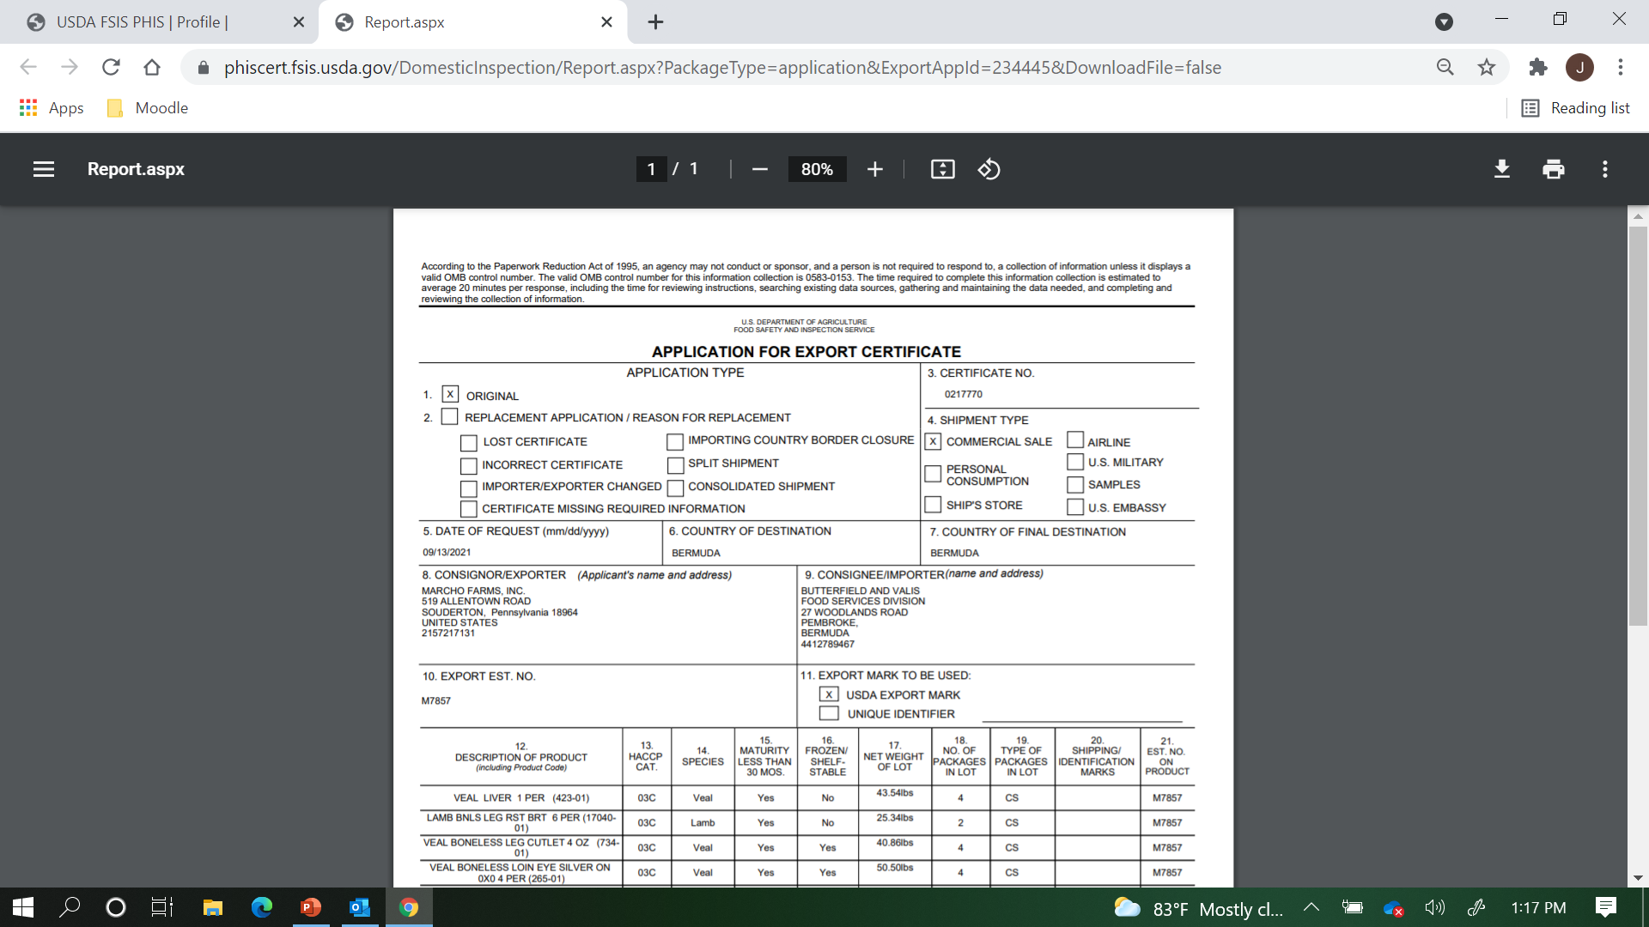
Notes:
Here we’re reviewing the application. You will also be looking at the certificate, and want to make sure the data matches up.

Slide 31
Joe Smith
Approve and Sign
Notes:
Now let’s look at the draft certificate package….

Slide 32
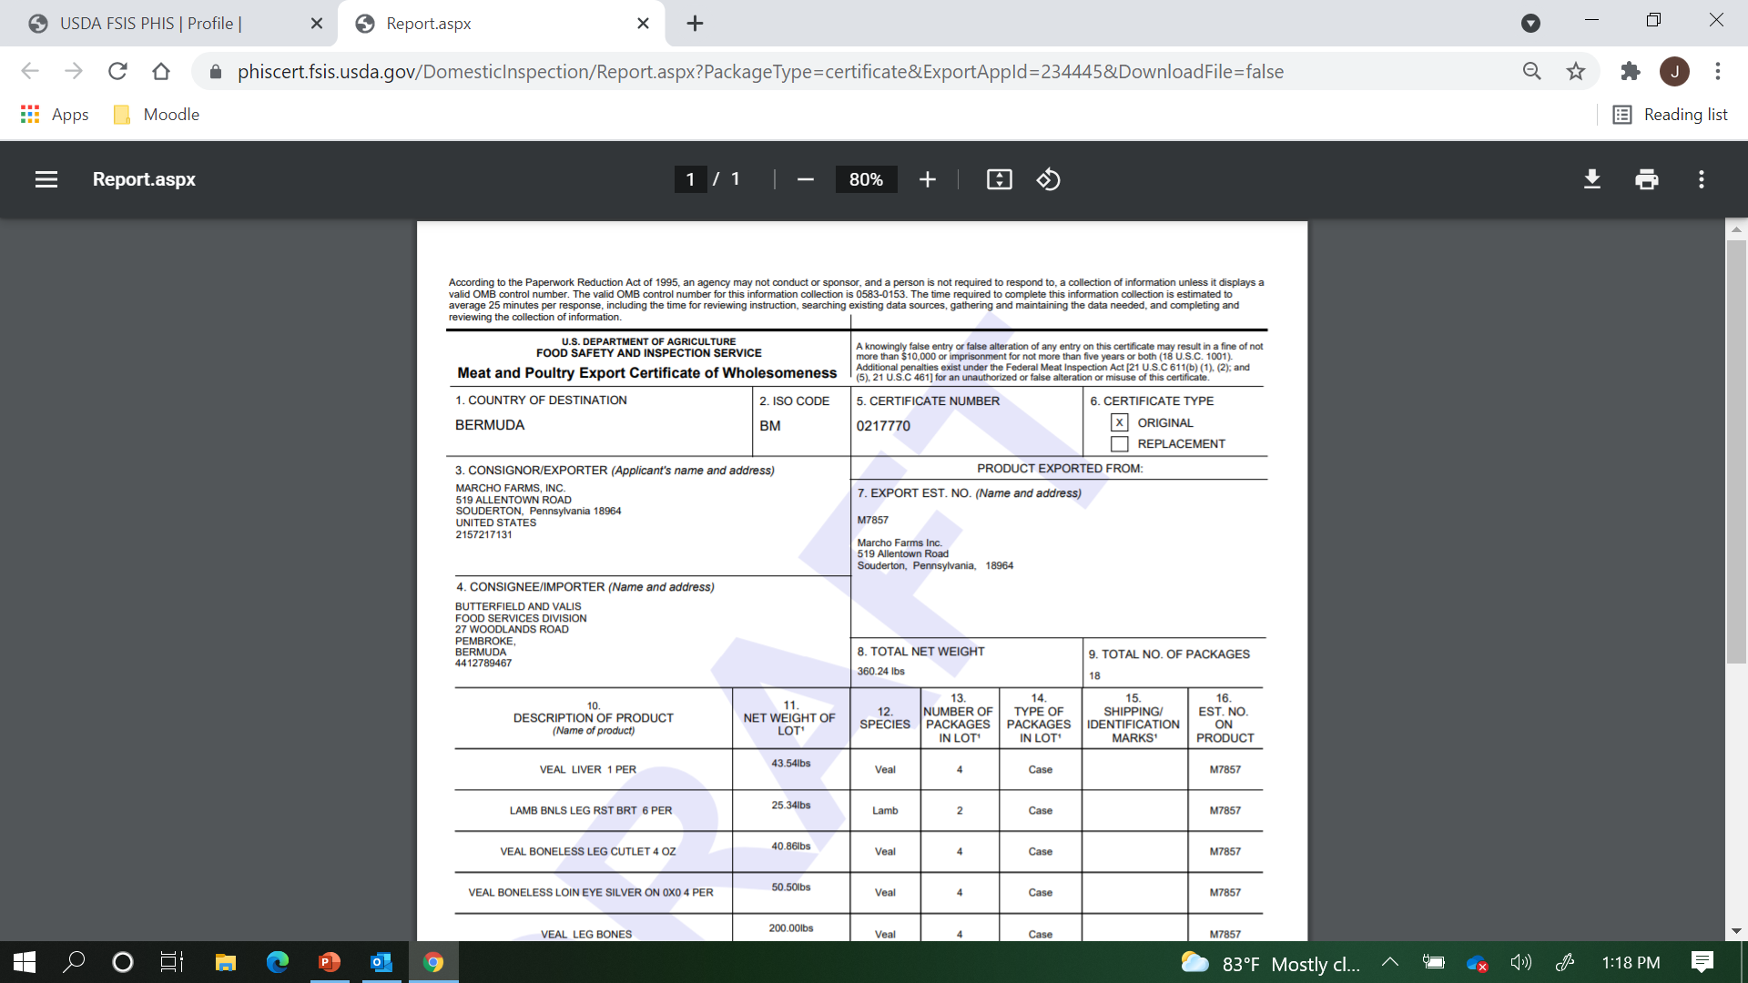
Notes:
Once we’ve reviewed it for accuracy and completeness, we can close it and return to PHIS.

Slide 33
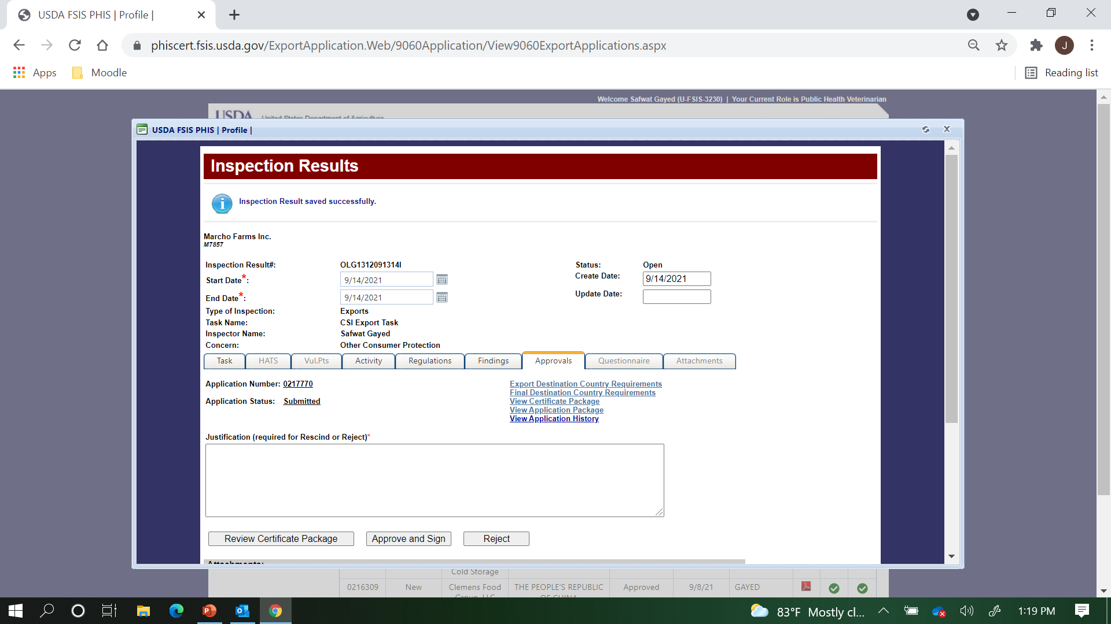
Joe Smith
Approve and Sign
Notes:
Now, with the new automatic digital signature function, you need to click on the “Review Certificate Package” button in order to have the option to sign….

Slide 34
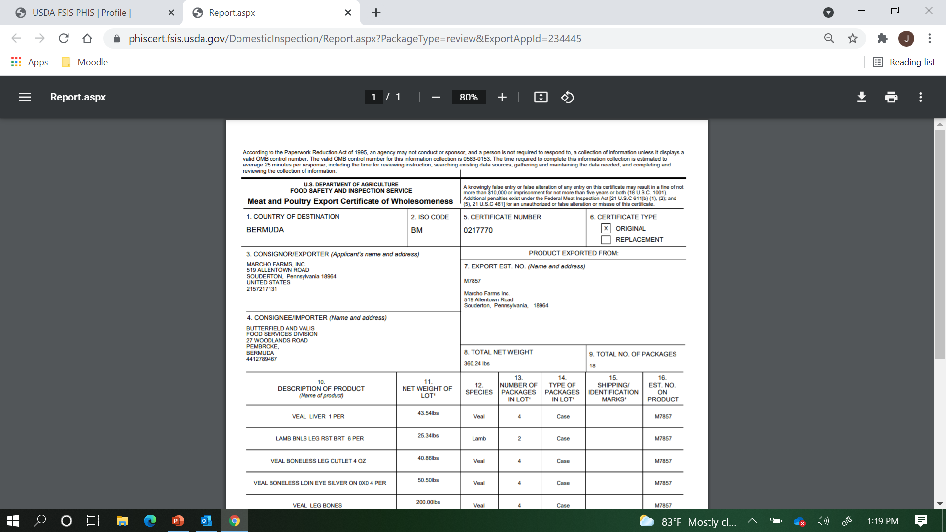
Notes:
Review the certificate, and any continuation pages or supplemental documents for accuracy and completeness. Scroll to the bottom….

Slide 35
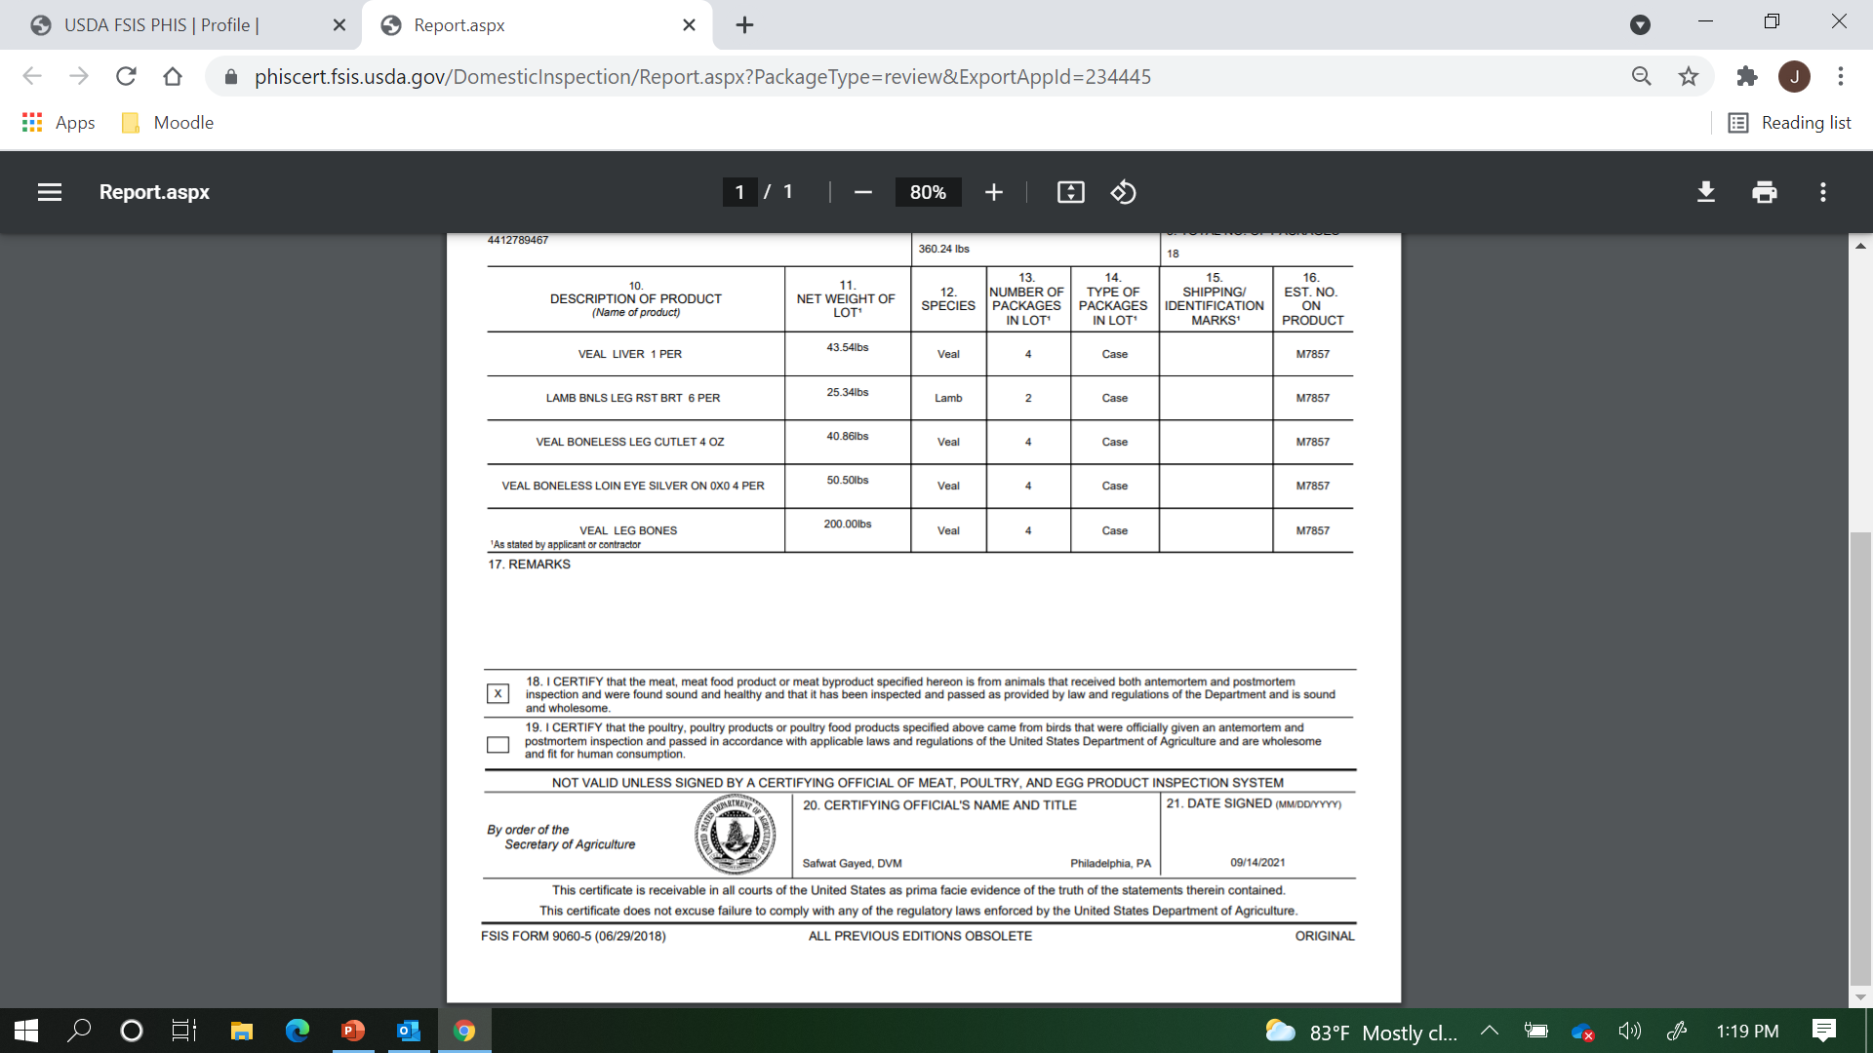
Joe Smith, CSI
Notes:
Here you can see your name and title and today’s date pre-printed. Close out and go back to PHIS.

Slide 36
Joe Smith
Notes:
Now you can see the “Approve and Sign” button is active. Since everything looked OK, click on it….

Slide 37
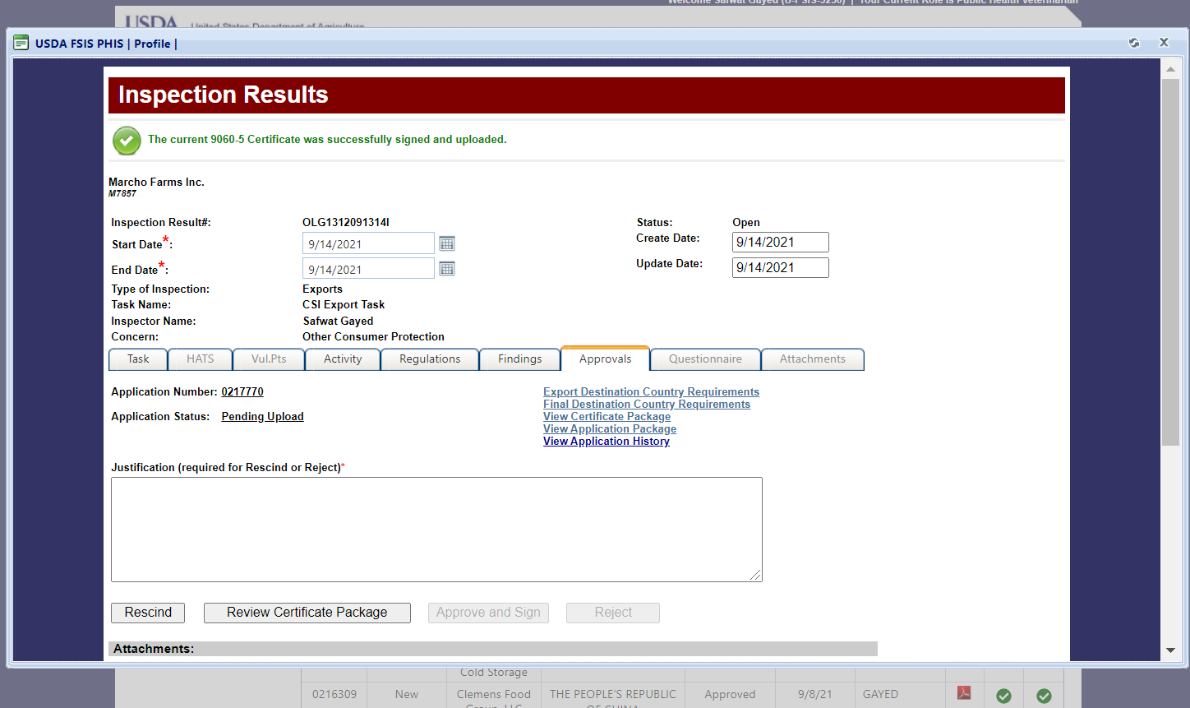
Joe Smith
Notes:
You see a green message at the top saying that the 9060-5 Certificate was successfully signed and uploaded.

Slide 38
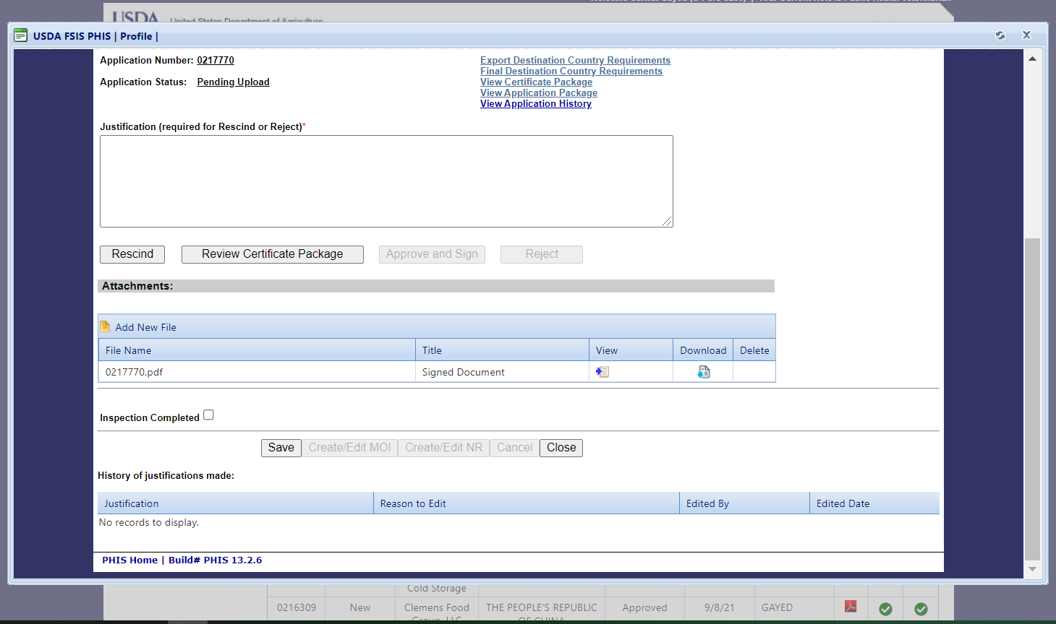
Notes:
At the bottom of the page, you see the Attachments grid, with the signed certificate uploaded. Click on the “View” icon to see your signed certificate.

Slide 39
Notes:
Here is the top half of the page…

Slide 40
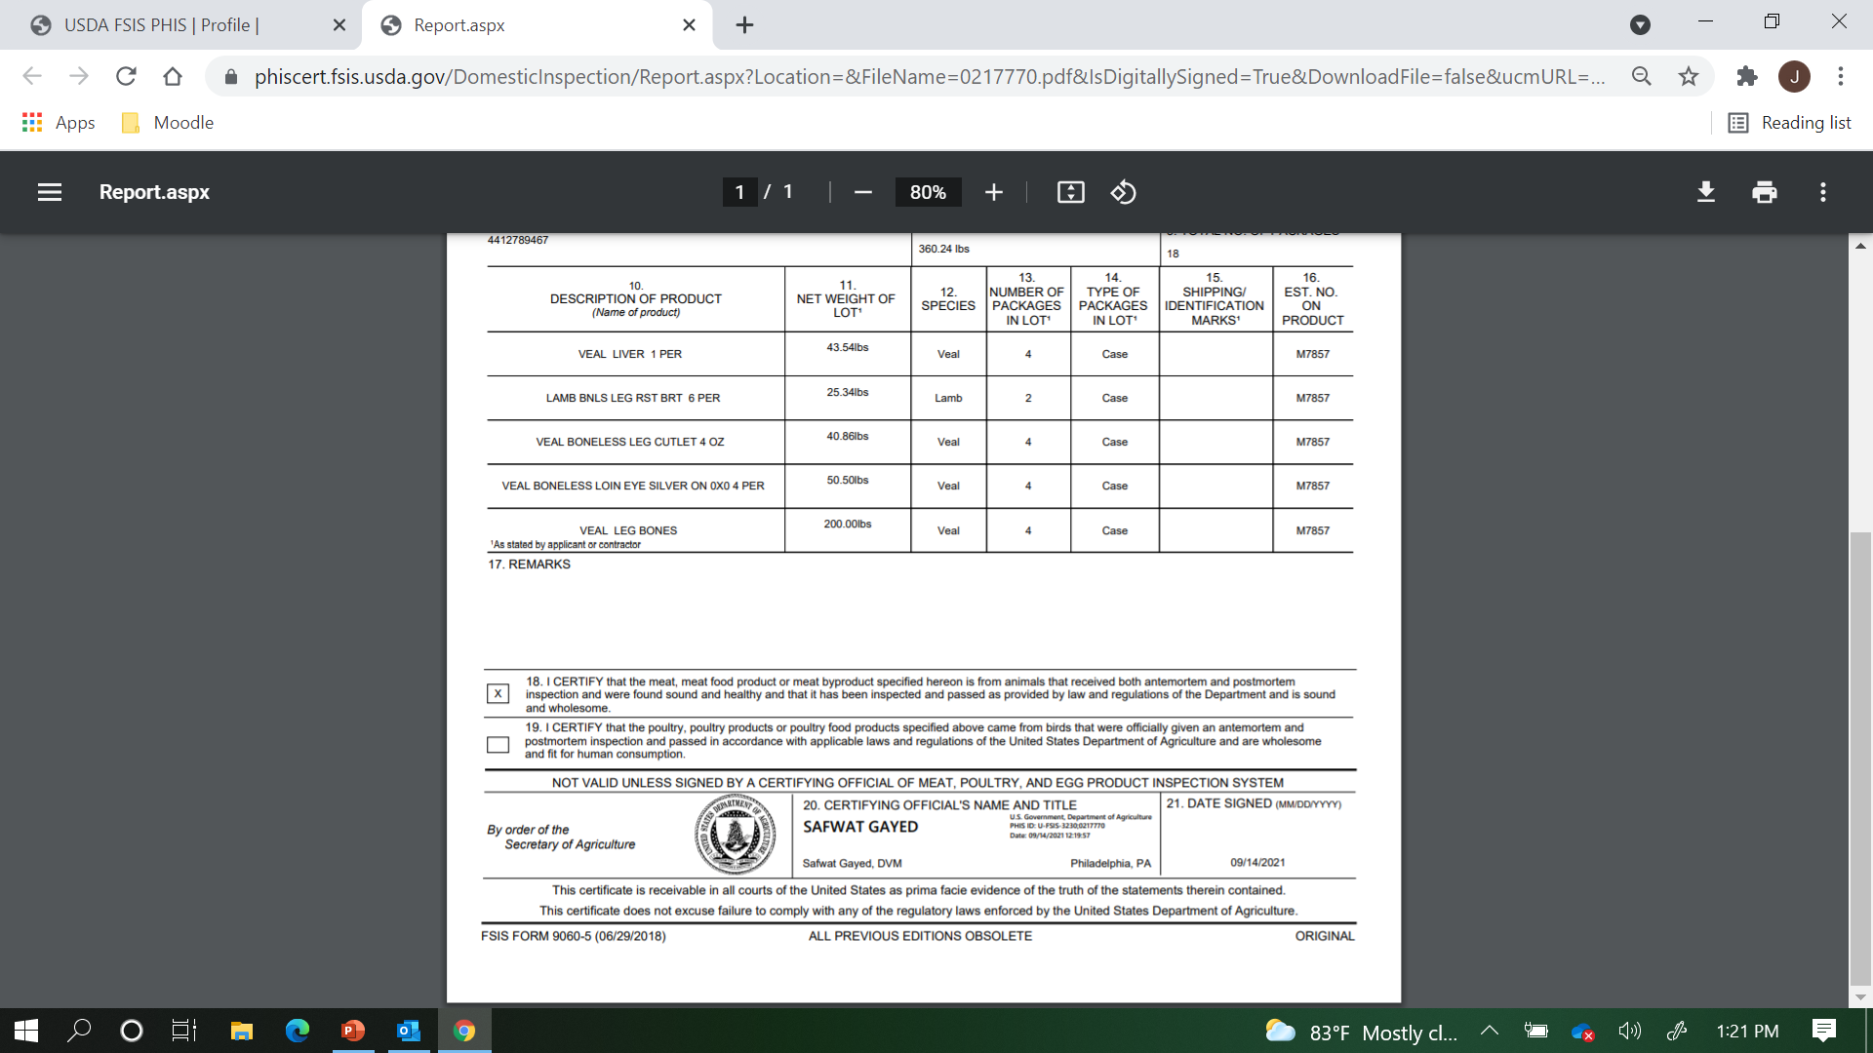
JOE SMITH
Joe Smith, CSI
Notes:
Now at the bottom, you can see a digital signature has been applied. You no longer need to use the Adobe Acrobat “Digitally Sign” function. Now go ahead and close the document.
You will need to print the certificate and any continuation pages on security paper, and any supplemental documents on plain white paper.

Slide 41
Notes:
Finally, you will need to check the “Inspection Complete” box.

Slide 42
Notes:
Then click save.

Slide 43
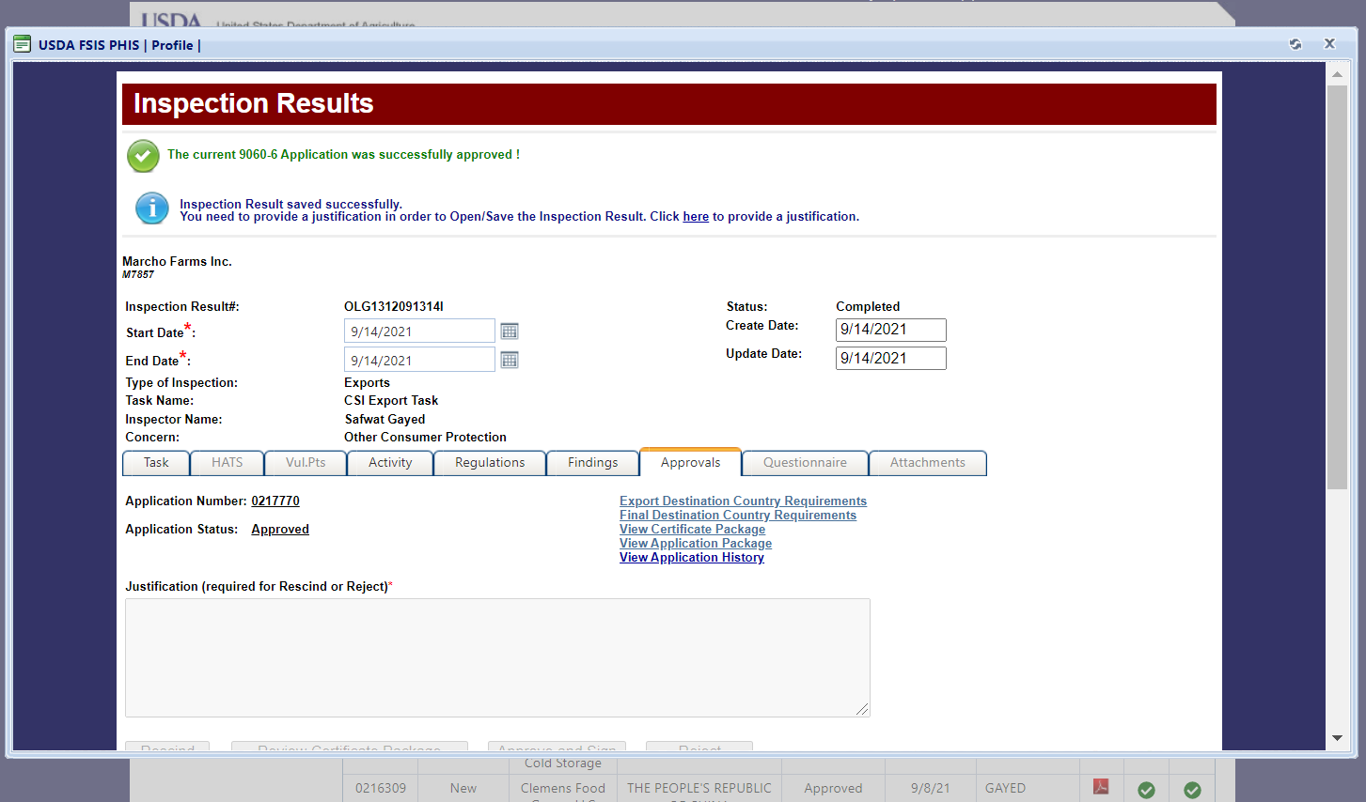
Joe Smith
Notes:
You can see your confirmation messages at the top of the screen.

Slide 44
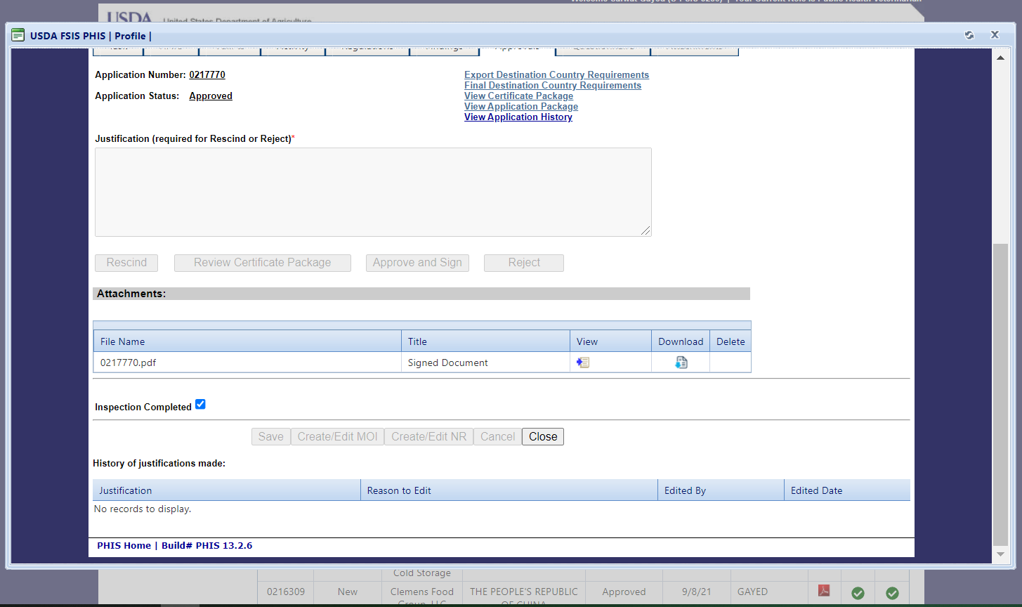
Notes:
Go ahead and close the Inspection Results page.

Slide 45
Consumer Safety Inspector
SMITH
SMITH
SMITH
SMITH
SMITH
SMITH
SMITH
Notes:
As you return to the View Export Records grid, you can see that your calendar icon has been changed to a green checkmark. You may now give the establishment the printed certificate package and inform them the product is approved for movement.

